Slide 1
Embedding a Graph in a Report
Notes:
Schedule: Timing Topic
<xx> minutes Lecture
<xx> minutes Practice
<xx> minutes Total

Slide 2
Objectives
  After completing this lesson, you should be able to do
  the following:
  Create and display a simple graph
  Customize a graph in a Web report
  Modify graph data dynamically
  Use graph hyperlinks
Notes:
Lesson Aim
<Enter lesson aim here.>

Slide 3
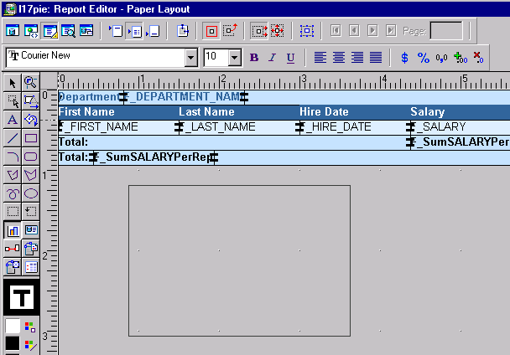
Adding a Graph to a Paper Report

Slide 4

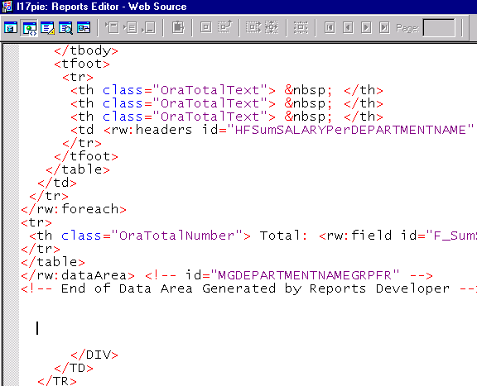
Adding a Graph to a Web Report

Slide 5
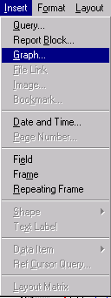
Adding a Graph to a Web Report

Slide 6
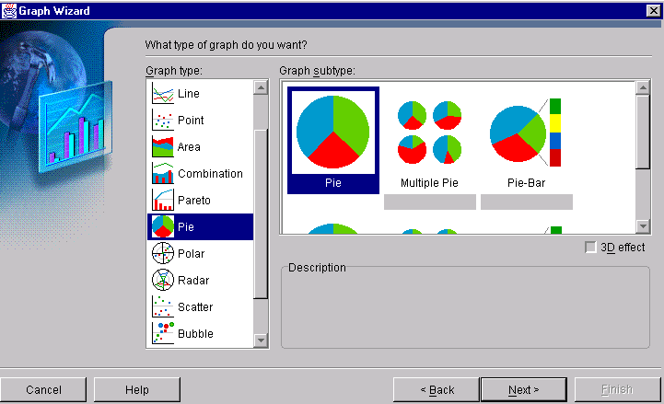
Selecting the Graph Type

Slide 7
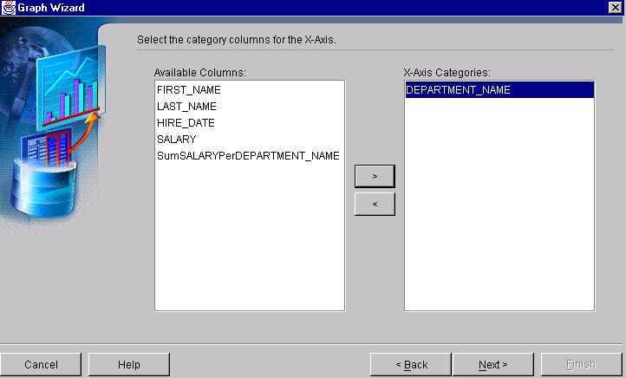
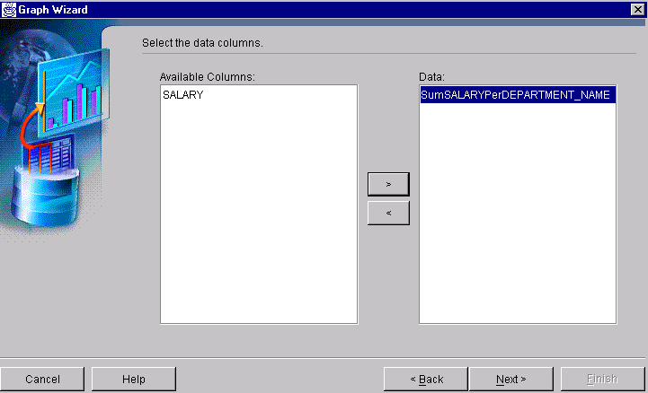
Selecting the Graph Data

Slide 8
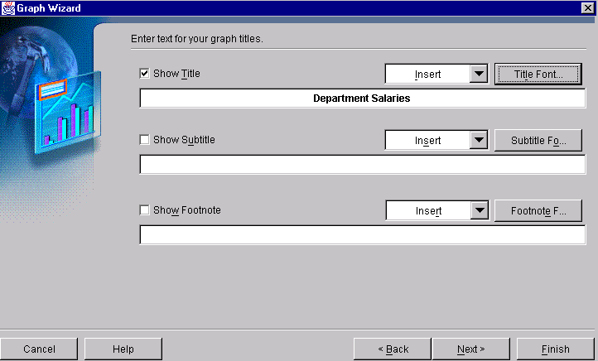
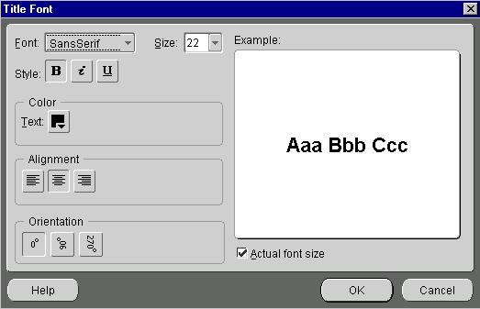
Adding Options to the Graph

Slide 9
The rw:graph Tag
  Defines a graph
  Attributes:
    id
    src
    groups
    dataValues
    series
    width
    height
    graphHyperlink
<rw:graph
id="graph-id"
src="group-name"
groups="column-list"
dataValues="list"
[series="column-list"]
[width="size"]
[height="size"]
[graphHyperlink="link"]
tag body
</rw:graph>

Slide 10
Customizing Web Graphs
<rw:graph id="graph" src="G_DEPARTMENT_ID"
groups="DEPARTMENT_ID"
dataValues="SALARY"
series="EMPLOYEE_ID,MANAGER_ID"
width="1200" height="600"
graphHyperlink="http://myhost.mycompany.com
/myexamples/emp.jsp?server=rep-server&
userid=hr/hr@orcl&destype=cache&
desformat=htmlcss&emp_id=&EMPLOYEE_ID;">
</rw:graph>
Graph XML

Slide 11
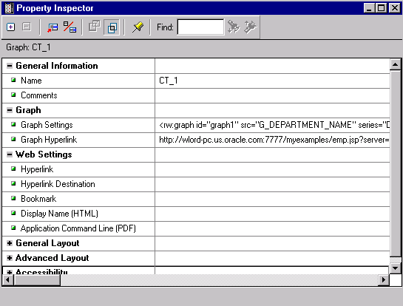
Using Graph Hyperlinks
  Document on same machine
  Any destination
  Any URL

Slide 12
Summary
  In this lesson, you should have learned how to:
  Build a new graph by invoking the Graph Wizard to build and embed a graph in a paper report
  Customize a graph in a Web report using the rw:graph tag
  Use a graph hyperlink for drilling down

Slide 13
Practice 17 Overview
  Using the Graph Wizard to create a graph
  Altering the graph in the Graph Wizard
  Creating graphs that print once for each record of a group
  Adding a graph to a Web layout
  Customizing a graph in a Web report

